Slide 1
Dijkstra’s Shortest Path Algorithm

Slide 2
Dr. Edsger w. Dijkstra
1930
Born: 1930 in Rotterdamn, Holland
1948–1956
Studied Mathematics and Theoretical Physics at the University of Leiden from 1948 -1956
1952—1962
Worked at the Mathematical Center in Amsterdam – First ever person hired as a programmer
1957
1962—1973
1973—1984
1984-1999
Married – Justice of the Peace would not accept programmer as profession
Professor of Mathematics at Technical University of Eindhoven, Holland
Research Fellow and Prof. Extraordinarius at Eindhoven
Prof. and Schlumberger Centennial Chair in CS at UT Austin
2002
Died in Nuenen, Netherlands

Slide 3

Shortest Path Algorithm

Slide 4
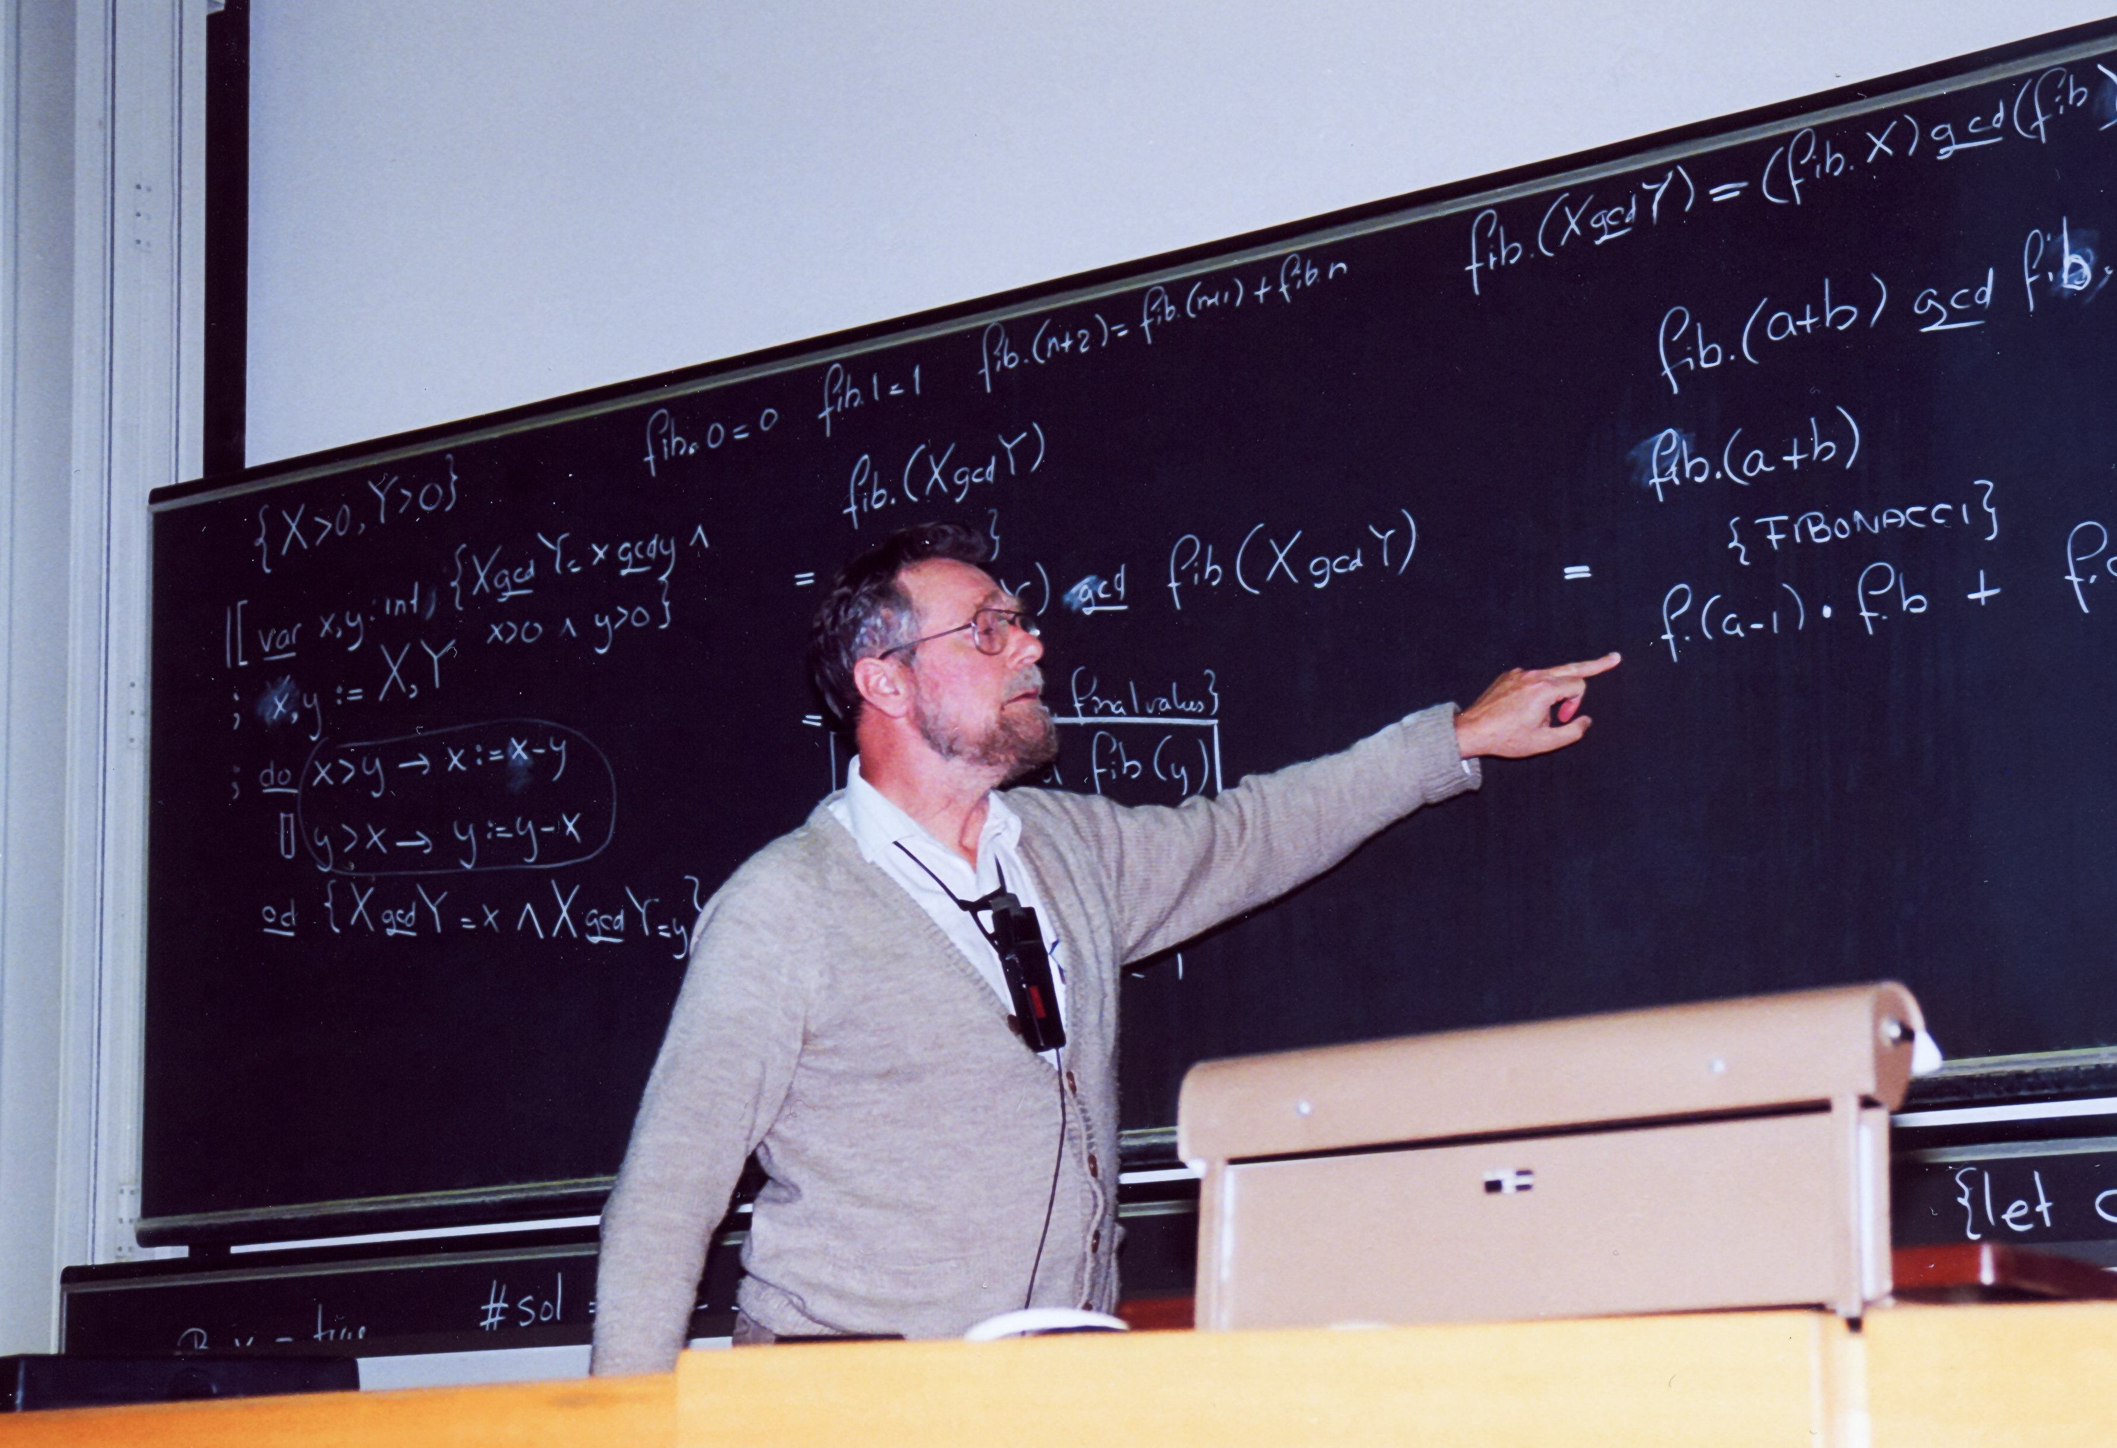
Demonstration

Slide 5
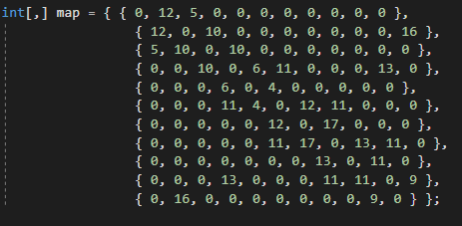
Incidence matrix
This method uses a simple data structure – the incidence matrix
Non-adjacent vertices are weighted 0
Adding a new vertex to the map requires adding all adjacencies to this matrix as well as changing the vertex # constant.

Slide 6
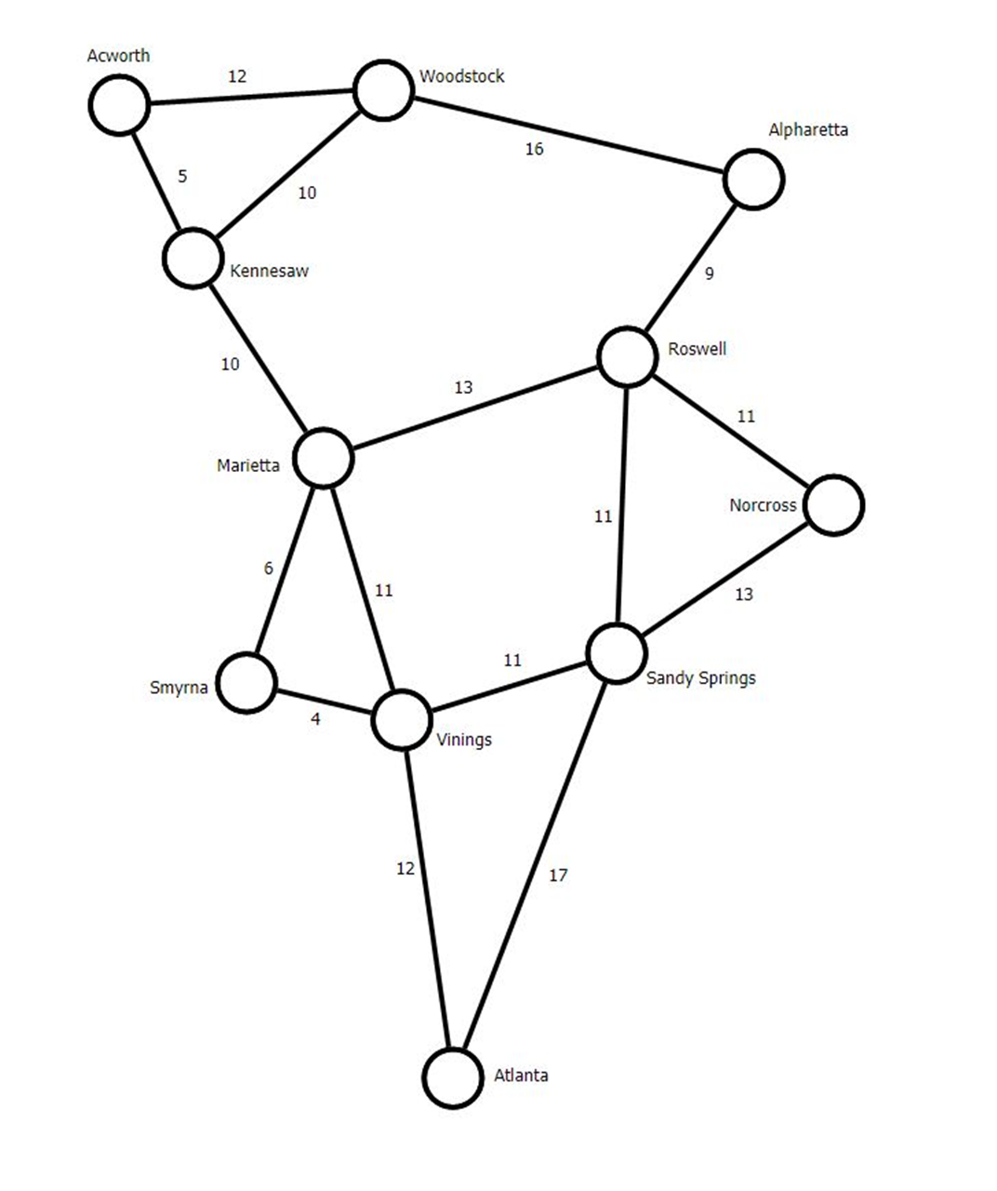

Slide 7
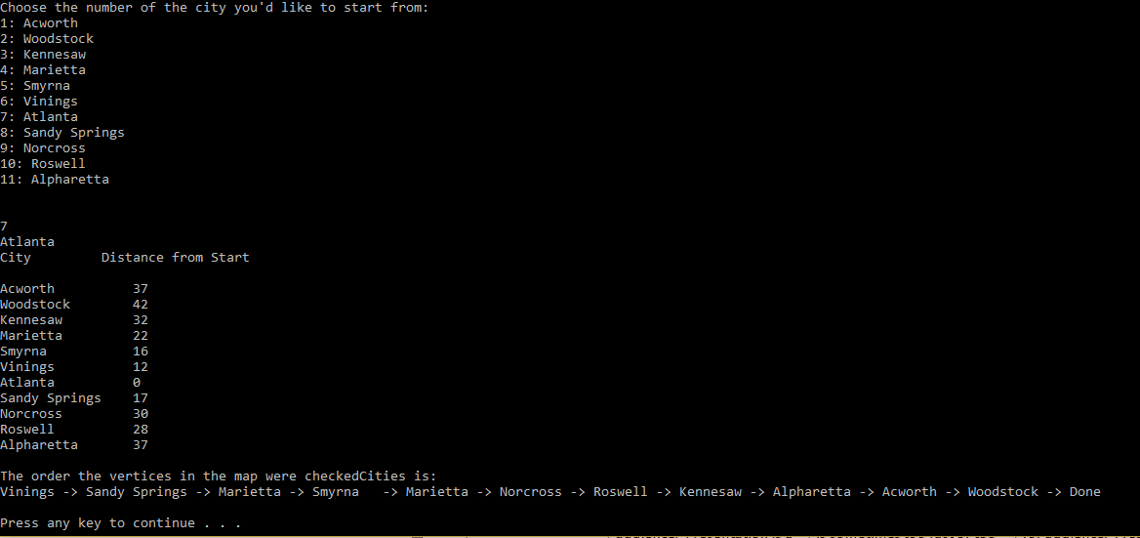
My application

Slide 8
Animations are helpful!!

Slide 9
Uses of Dijkstra’s shortest path algorithm
The most obvious and most often acknowledged… Google Maps!
Also useful is mapping and planning networks
Was used as the basis for the shortest path search algorithm

